Slide 1

Path Planning Algorithms
Mohamed Saied

Slide 2
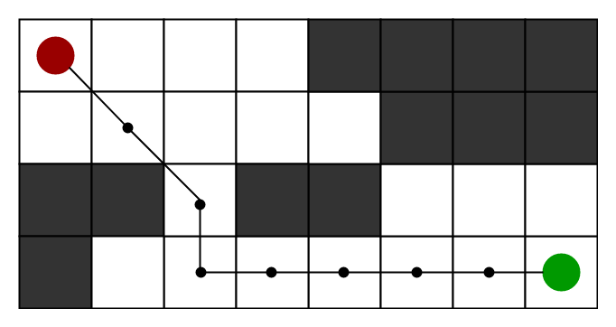
Motivation
To approximate the shortest path in real-life situations, like- in maps, games where there can be many hindrances. We can consider a 2D Grid having several obstacles and we start from a source cell (colored red below) to reach towards a goal cell (colored green below) it means that Path planning is a search problem.

Slide 3

How to Analyze Algorithms

Slide 4
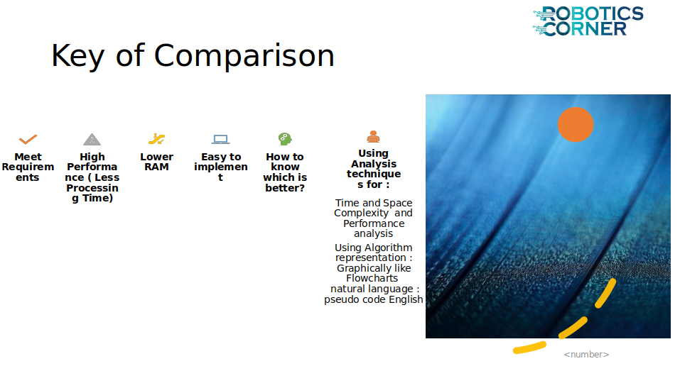

Slide 5
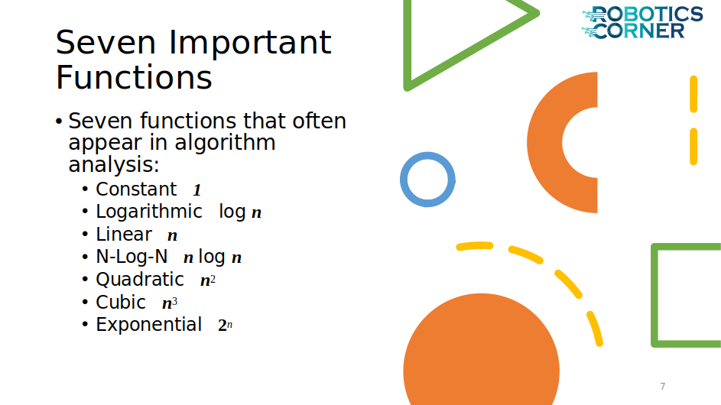

Slide 6
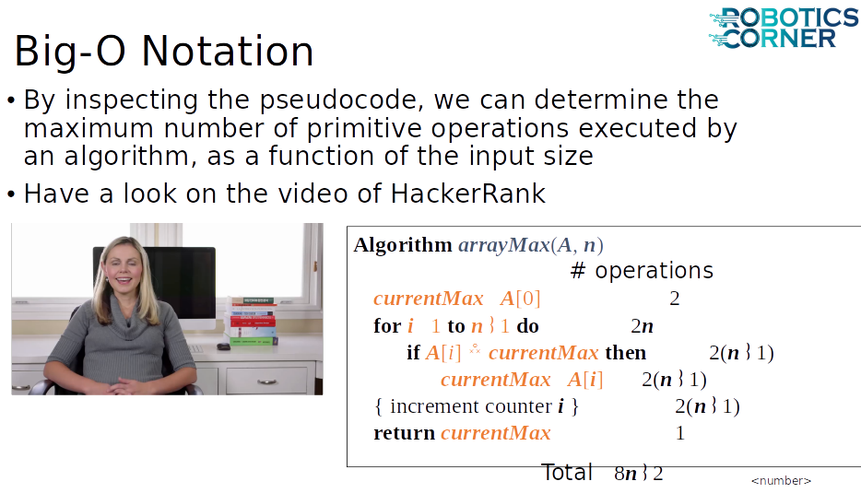

Slide 7
Available Search Algorithms
A* (AStar) Algorithm
Dijkstra’s Algorithm
Bellman-Ford Algorithm
Floyd-Warshall Algorithm

Slide 8
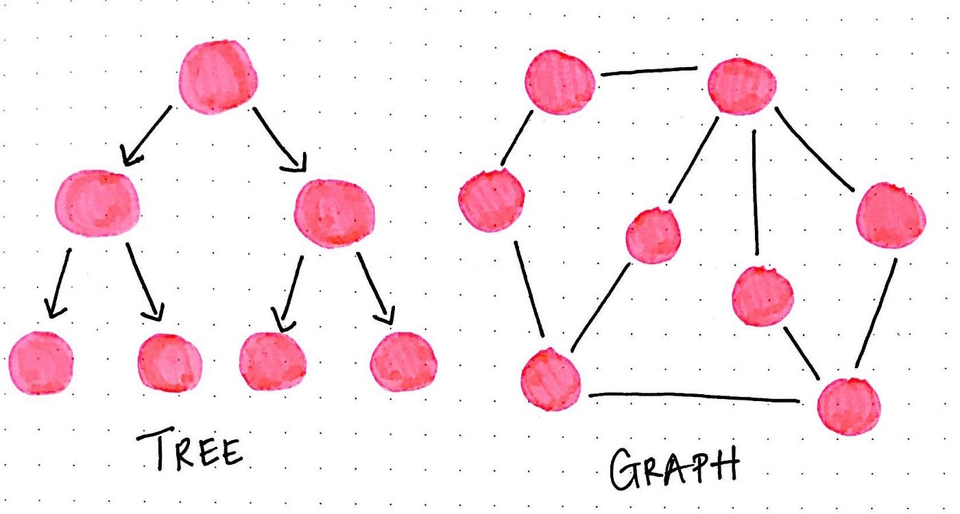
Tree vs Graph

Slide 9
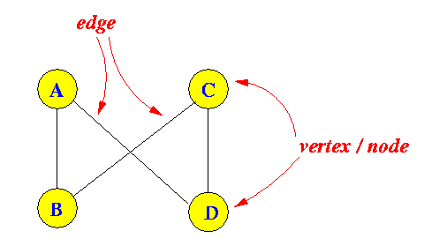
Graph Theory
Graph theory is a branch of mathematics that deals with the study of graphs, which are mathematical structures used to model pairwise relations between objects. A graph consists of two main components: vertices (also called nodes) and edges (also called links or connections).

Slide 10
Graph parameters
Vertices: These are the fundamental units within a graph. They can represent any discrete object or entity, like cities in a map, people in a social network, or data points in a network.
Edges: These are the connections between pairs of vertices. They can be undirected, meaning they represent a symmetric relationship (like friendships between people), or directed, indicating a one-way relationship (like following someone on social media).

Slide 11
Why A*?
Informally speaking, A* Search algorithms, unlike other traversal techniques, it has “brains”. What it means is that it is really a smart algorithm which separates it from the other conventional algorithms. This fact is cleared in detail in below sections. And it is also worth mentioning that many games and web-based maps use this algorithm to find the shortest path very efficiently (approximation).

Slide 12
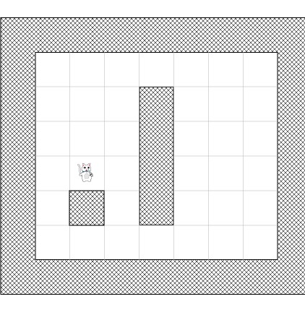
Example
Let’s imagine that we have a game where a cat wants to find a way to get a bone.
“Why in the world would a cat want a bone?!” you might think. Well in our game, this is a crafty cat and it wants to pick up bones to give to dogs, to avoid getting itself chomped! :]
So imagine the cat in the picture below wants to find the shortest path to the bone:

Slide 13
Cat Example
Sadly, the cat can’t go straight from his current position to the bone, because there is a wall blocking the way, and it's not a ghost cat in this game!
And the cat in this game is also quite lazy, so he always wants to find the shortest path so he’s not too tired when it gets back home to see his female ;-)
But how can we write an algorithm to figure out which path the cat should take? A* to the rescue!

Slide 14
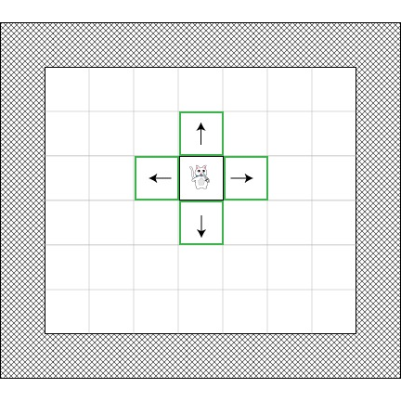
Open and Closed lists
Now that we’ve created a simplified search area, let’s discuss how the A* algorithm works.
In addition to being lazy, our cat does not have a good memory, so it will need two lists:
One to write down all the squares that are being considered to find the shortest path (called the open list)
One to write down the square that does not have to consider it again (called the closed list
The cat begins by adding his current position (we’ll call this starting position point “A”) to the closed list. Then, he adds all walkable tiles adjacent to his current position to the open list.
Here’s an example of what this would look like if the cat was out in the open (green representing the open list):

Slide 15
Path scoring
Now the cat need to determine which of these options would be on the shortest path, but how can he choose?
Well in the A* path algorithm, this is done by giving a score to each square, which is called path scoring. Let’s see how it works!

Slide 16
Path Scoring parameters
We’ll give each square a score G + H where:
G is the movement cost from the start point A to the current square. So for a square adjacent to the start point A, this would be 1, but this will increase as we get farther away from the start point.
H is the estimated movement cost from the current square to the destination point (we’ll call this point B for Bone!) This is often called the heuristic because we don’t really know the cost yet – it’s just an estimate.

Slide 17
movement cost
You may be wondering what we mean by “movement cost”. Well in this game it will be quite simple – just the number of squares.
However, keep in mind that you can make this different for our game. For example:
If you allowed diagonal movement, you might make the movement cost a bit bigger for diagonal moves.
If you had different terrain types, you might make some cost more to move through – for example a swamp, water, or a Catwoman poster ;-)
That’s the general idea – now let’s dive into more specifics about figuring out G and H.

Slide 18
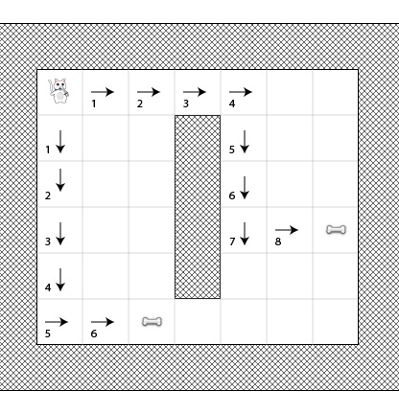
More about G
Recall that G is the movement cost (in number of squares for this game) from the start point A to the current square.
In order to calculate G, we need to take the G of its parent (the square where we came from) and to add 1 to it. Therefore, the G of each square will represent the total cost of the generated path from point A until the square.
For example, this diagram shows two paths to two different bones, with the G score of each square listed on the square:

Slide 19
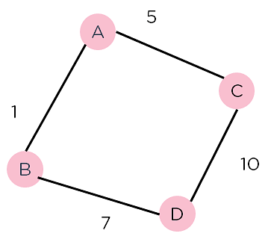
A* how it works
Consider the weighted graph depicted above, which contains nodes and the distance between them. Let's say you start from A and have to go to D.
Now, since the start is at the source A, which will have some initial heuristic value. Hence, the results are
f(A) = g(A) + h(A) f(A) = 0 + 6 = 6
Next, take the path to other neighbouring vertices :
f(A-B) = 1 + 4
f(A-C) = 5 + 2
Now take the path to the destination from these nodes, and calculate the weights :
f(A-B-D) = (1+ 7) + 0
f(A-C-D) = (5 + 10) + 0
It is clear that node B gives you the best path, so that is the node you need to take to reach theIt is clear that node B gives you the best path, so that is the node you need to take to reach the destination.

Slide 20
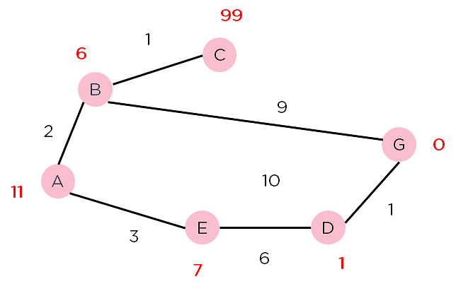
Path Scoring

Slide 21
Steps pathfinding
The first step in pathfinding is to simplify the search area into something easily manageable.
How to do this depends on the game. For example, we could divide the search area into pixels, but that’s a granularity which is too high (and unnecessary) for our a tile-based game like this.
So instead, we will use the tile (a square shape) as unit for the pathfinding algorithm. Variants with other type of shapes are possible (such as triangles or hexagons), but the square is the best fit for our needs and is also the simplest.
Divided like that, our search area can be simply represented by a two dimensional array sized like the map it represents. So if the level is a map of 25*25 tiles, our search area will be an array of 625 squares. If we’ve divided our map into pixels, the search area would have to be an array of 640,000 squares (A tile is 32*32 pixels)!
So let’s take the screenshot we started with and divide it into tiles to represent the search area (in this simple example, 7×6 tiles = 42 tiles total):

Slide 22
Types of Distance Metrics used in A*
Manhattan Distance
Euclidean Distance

Slide 23
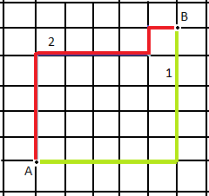
Manhatan Distance
We use Manhattan distance, also known as city block distance, or taxicab geometry if we need to calculate the distance between two data points in a grid-like path. Manhattan distance metric can be understood with the help of a simple example.

Slide 24

Manhatan How it works!
In the above picture, imagine each cell to be a building, and the grid lines to be roads. Now if I want to travel from Point A to Point B marked in the image and follow the red or the yellow path. We see that the path is not straight and there are turns. In this case, we use the Manhattan distance metric to calculate the distance walked.​

Slide 25
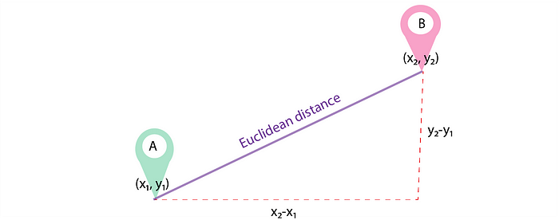
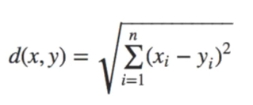
Euclidean Distance
Euclidean distance is the straight line distance between 2 data points in a plane.
It is calculated using the Minkowski Distance formula by setting ‘p’ value to 2, thus, also known as the L2 norm distance metric. The formula is:-
This formula is similar to the Pythagorean theorem formula, Thus it is also known as the Pythagorean Theorem.

Slide 26
Pesudo code
Make an open list containing starting node
If it reaches the destination node :
Make a closed empty list
If it does not reach the destination node, then consider a node with the lowest f-score in the open list
We are finished
Else :
Put the current node in the list and check its neighbors
For each neighbor of the current node :
If the neighbor has a lower g value than the current node and is in the closed list:
Replace neighbor with this new node as the neighbor’s parent
Else If (current g is lower and neighbor is in the open list):
Replace neighbor with the lower g value and change the neighbor’s parent to the current node.
Else If the neighbor is not in both lists:
Add it to the open list and set its g

Slide 27
Algorithm
1. Initialize the open list 2. Initialize the closed list put the starting node on the open list (you can leave its f at zero) 3. while the open list is not empty a) find the node with the least f on the open list, call it "q" b) pop q off the open list c) generate q's 8 successors and set their parents to q d) for each successor i) if successor is the goal, stop search ii) else, compute both g and h for successor successor.g = q.g + distance between successor and q successor.h = distance from goal to successor (This can be done using many ways, we will discuss three heuristics-Manhattan, Diagonal and Euclidean Heuristics) successor.f = successor.g + successor.h iii) if a node with the same position as successor is in the OPEN list which has a lower f than successor, skip this successor iV) if a node with the same position as successor is in the CLOSED list which has a lower f than successor, skip this successor otherwise, add the node to the open list end (for loop) e) push q on the closed list end (while loop)

Slide 28
Thank you

